Slide 1
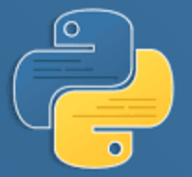
Python

Slide 2
Introduction
Python is one of the fastest growing language in terms of the number of developers using it and the number of libraries it has.
Python is a general purpose language because it has many uses, some of this are in machine learning, GUI, software development, and also in website development.
Why learn Python?
Python is a high-level, interpreted, object-oriented programming language.
Python is one of the easiest language to learn available in the market because it is much simpler than other programming languages.
Python uses English keywords, simple structure and clear defined syntax thus making it easy to understand.
Python has a huge library that is compatible to different platforms such as UNIX, Windows, and Macintosh and it also provides interfaces to all major databases.

Slide 3
Development Environment
What do we need to get started?
Python Interpreter ( This tutorial will be on version 3.X ) – since python is an interpreted programming language, we need to install python interpreter in our local machine which will convert our code into a binary code. Take note that version 3.X has some difference with version 2.X
Integrated Development Environment (IDE) – some of these IDEs are Pycharm, Sublime, Atom, Thonny, etc. (This tutorial will be using Pycharm). This is where we write , run , and debug our codes.

Slide 4




Getting Started
Python language has similarities to Ruby and Perl in terms of how the code is constructed because it is easy to learn and understand.
To start, open IDE and let us execute our first program.
As we can see in our code, python doesn’t need a semicolon in the end of every code we make.
Python also doesn’t need braces to indicate blocks of codes, it simply use indentations so all of the codes indented with the same number of spaces would form a block.
Quotations:
Getting back on the printing of string, we use double quotations but python also accepts single quotation.
We can use the double quotation to display a string with single quotation.

Slide 5



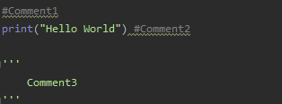
Getting Started
We can also use the single quotation to display a string with double quotation.
There is also the triple quotation that is use to span the string across multiple lines
Comments:
Python also provide a way to comment both single and multiple lines
Identifiers:
Python identifiers is a string or name used to identify variable, function, class, module or any other objects.
Python identifier starts with a letter or an underscore (_).
Unlike other languages, python identifier does not allow punctuation characters such as @, $, and %.
Python is a case sensitive language so “var1” is different from “Var1”.

Slide 6
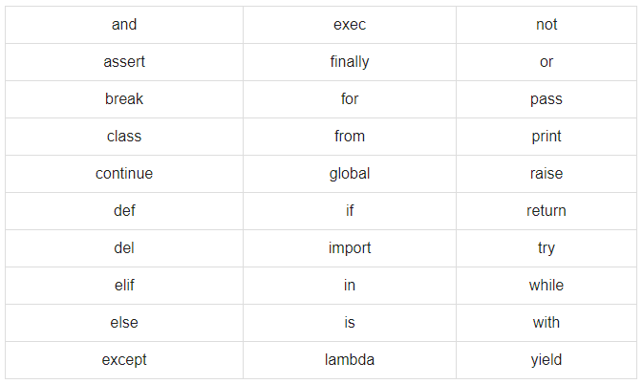
Getting Started
Naming Conventions for Python Identifiers.
Class name starts with a uppercase letters while al other identifiers starts with a lowercase letter.
Identifier that starts with a single underscore is a private identifier.
Identifier that starts with a two underscore is a strongly private identifier.
Identifier that starts and end another two underscore is a language defined special name.
Reserved words:
These words are Python keywords and we cannot use them as constant, variable, or any other identifier names.

Slide 7



Variables
Variables are basically a container that has a variable name and a value.
We have a variable name equal to a value, so in the example we are assigning “12” and “Hello World” to num and str1.
In Python we don’t need to define the type of the variable because it automatically detects what type of variable it is.
Unlike other programming language, Python supports multiple assignment of variables.
Pythons allows assigning single value to multiple variables.
Python allows assigning multiple objects to multiple variables.

Slide 8







Data Types
When we work on a project, it is important what type of data we are working with so that we can process the data in that format because if we are processing it in a wrong data type we may experience errors or bugs in our codes.
Python data types:
None – this is when we have a variable but doesn’t contain any values, its type is None, in other programming language it is called null.
Numeric – in a Numeric, it has multiple types; int, float, complex, bool.
Int are for whole numbers.
Float are for numbers with decimals.
Complex are for numbers plus or minus an imaginary number.
Bool is for true or false. In Python we also use 1 and 0 as true or false.

Slide 9









Data Types
String
List
Tuple
Set
Range
Dictionary
We will be discussing more about string, dictionary, list, tuples, set, and ranges in the following slides.

Slide 10
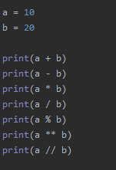
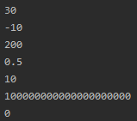
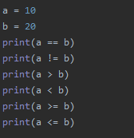
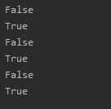
Operators
Python provides many basic operators that we can use in our codes.
Arithmetic Operators:
Comparison Operators:

Slide 11
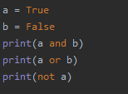



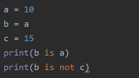

Operators
Logical Operators:
Membership Operators:
Identity Operators:

Slide 12







Working with Strings
We can create string by simply enclosing characters in quotes, it may be in a single, double or triple quotes depending on what text we will be having.
As you can see, we used a variable to hold our string for us to manipulate or process the string.
We can think of string as an individual string of characters and we can access these characters individually or multiple characters at a time.
We can accomplish this by using one of the special operators of string which is the Slice. Slice gives the character from the given index by using square brackets.
Another special operator is Range slice where it will give the characters from the given range.
Using the Range slice, if we don’t put anything in the starting range, it will automatically starts from the beginning, while if we don’t put anything in the end of the range, it will end at the very last character.

Slide 13




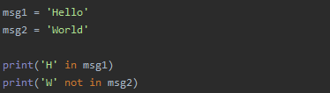





Working with Strings
Other Special operators:
Concatenation – where we add two or more strings.
Repetition – where we use multiplication to create copies of the string.
Membership – where it returns true or false if a certain character exist in the given string.
String Formatting:
There are many kinds of format symbol but most of the time we may be using %c for character, %s for string, and %d for integer.
Much simpler string format is by the use of placeholder.

Slide 14
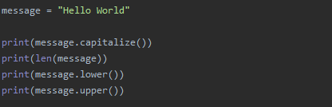

Working with Strings
Built-in String Methods:
There are a lot of string methods available in python, for now think of methods as something that do a certain action.
Some of these built-in methods are:
Explore more of these built-in methods

